Slide 1



INVERTIBLE CONVOLUTIONAL NETWORKS
MARC FINZI*1 PAVEL IZMAILOV*1 WESLEY MADDOX*1 POLINA KIRICHENKO*1 ANDREW GORDON WILSON1
SUJAN
SUMIT
TEJA
PAVITHRAN

Slide 2

Invertibility
INVERTIBILITY REFERS TO THE ABILITY OF A NETWORK OR LAYER TO MAP AN OUTPUT BACK TO ITS EXACT ORIGINAL INPUT.
Convolution
MATHEMATICAL PROCESS OFTEN USED FOR ANALYZING SPATIAL OR TEMPORAL PATTERNS IN DATA.

Slide 3

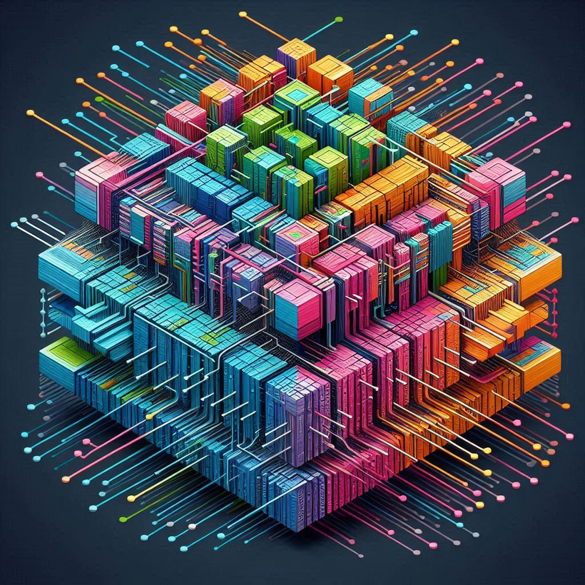

NETWORK
Networks are computing systems designed to simulate the way human brains process information.
ICN
INVERTIBLE CONVOLUTIONAL NETWORKS ARE A TYPE OF NEURAL NETWORK ARCHITECTURE WHERE EACH LAYER, INCLUDING THE CONVOLUTIONAL LAYERS, IS DESIGNED TO BE REVERSIBLE. THIS MEANS THAT GIVEN AN OUTPUT FROM THE NETWORK, IT IS POSSIBLE TO EXACTLY RECONSTRUCT THE ORIGINAL INPUT BY APPLYING THE INVERSE OF EACH LAYER’S OPERATION.

Slide 4


Advantages
OFFER SEVERAL KEY ADVANTAGES IN DEEP LEARNING, PARTICULARLY IN TASKS SUCH AS IMAGE GENERATION, RECONSTRUCTION
EXACT RECONSTRUCTION
BIJECTIVE
MAPPING
ICNS PROVIDE A BIJECTIVE (ONE-TO-ONE AND ONTO) MAPPING BETWEEN INPUT AND OUTPUT. THIS ENSURES THAT EVERY POINT IN THE OUTPUT CORRESPONDS TO EXACTLY ONE POINT IN THE INPUT, PRESERVING STRUCTURE AND SEMANTICS ACROSS THE TRANSFORMATION. THIS IS PARTICULARLY USEFUL IN TASKS LIKE IMAGE GENERATION, WHERE EVERY PIXEL MUST CORRESPOND TO SOME MEANINGFUL LATENT VARIABLE.
ALLOW FOR EXACT RECONSTRUCTION OF INPUT DATA FROM THE OUTPUT. SINCE THE TRANSFORMATIONS ARE INVERTIBLE, THE PROCESS IS REVERSIBLE, MEANING THAT THE ORIGINAL INPUT CAN BE PERFECTLY RECOVERED FROM THE OUTPUT WITHOUT LOSS OF INFORMATION.

Slide 5
AIM:-
IMPLEMENTING INVERTIBLE CONVOLUTIONAL NETWORKS
USING IT’S APPLICATIONS
AIM TO MAINTAIN THE ARCHITECTURE'S DISCRIMINATIVE POWER WHILE ENABLING EXACT INVERSION.
APPLICATIONS:-
IMAGE RECONSTRUCTION AND SUPER-RESOLUTION
SCIENTIFIC AND MEDICAL IMAGING
FEATURE VISUALIZATION AND INTERPRETABILITY
MEMORY-EFFICIENT TRAINING IN NEURAL NETWORKS
GENERATIVE MODELING AND NORMALIZING FLOWS

Slide 6
Code Implementation
Dataset preparation
The torch and torch.nn modules are for building and training neural networks. torchvision.transforms and torchvision.datasets provide tools to prepare and load the dataset (CIFAR-10)..
Defining ICN
Create a custom invertible convolution layer InvertibleConvLayer with:
A forward function to apply a convolution operation.
An inverse function intended to perform the reverse operation.
Construct the full network ICN by stacking multiple InvertibleConvLayer layers.
Implement:
A forward method to process input images layer-by-layer.
An inverse method to reverse the operations in each layer, used for image generation.

Slide 7
Train the Model
For each epoch:
Loop over the data batches, moving images to the GPU.
Pass the images through the model’s forward method to get reconstructions.
Compute the loss between the reconstructions and original images, then backpropagate to adjust weights.
Print the average loss per epoch to monitor training progress.
Generate and Visualize Images
Implement generate_images to generate new images by sampling random latent vectors and passing them through the model’s inverse function.

Slide 8
Results of Image Reconstruction

Slide 9
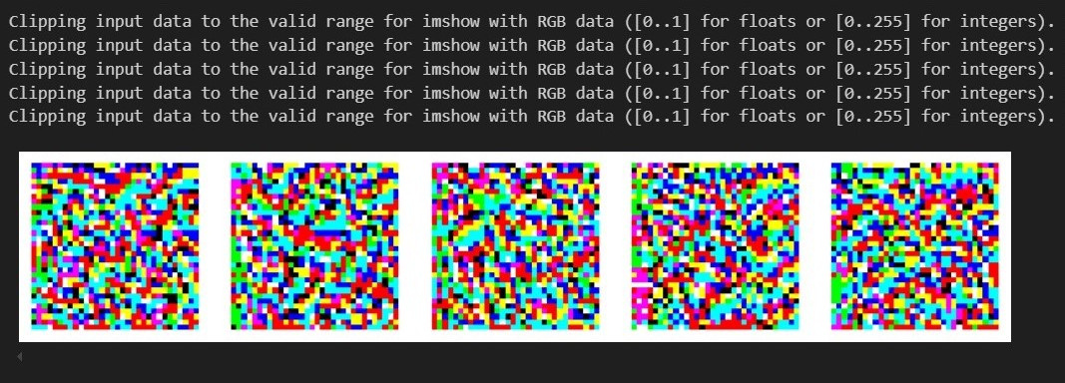
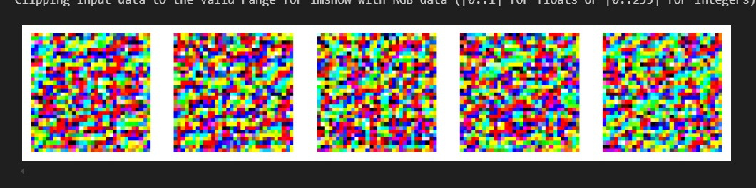
Module trained on 10 datasets
Module trained on 100 datasets

Slide 10
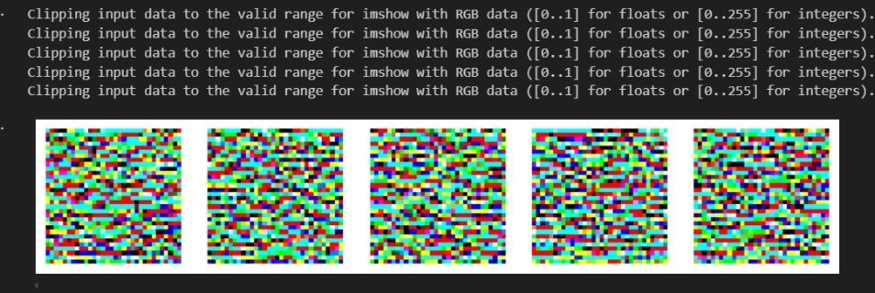
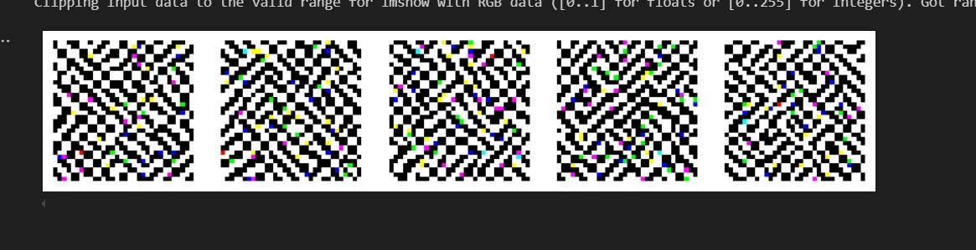
Module trained on
1000 datasets
Module trained on 5000 datasets

Slide 11
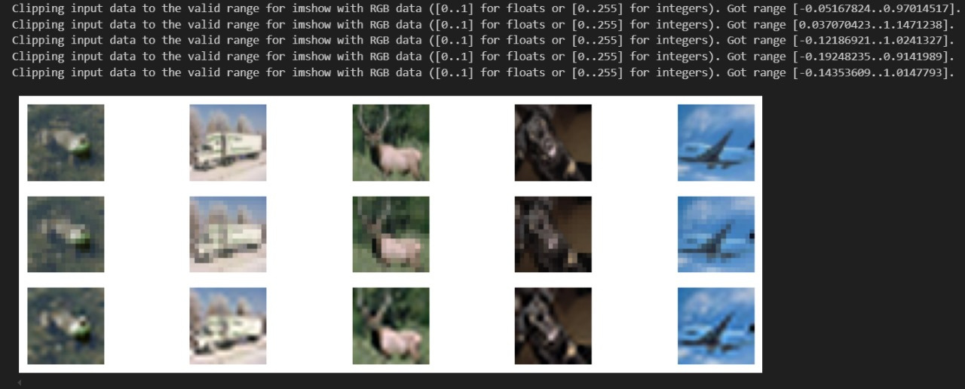
Results of implementation of Image Resolution

Slide 12
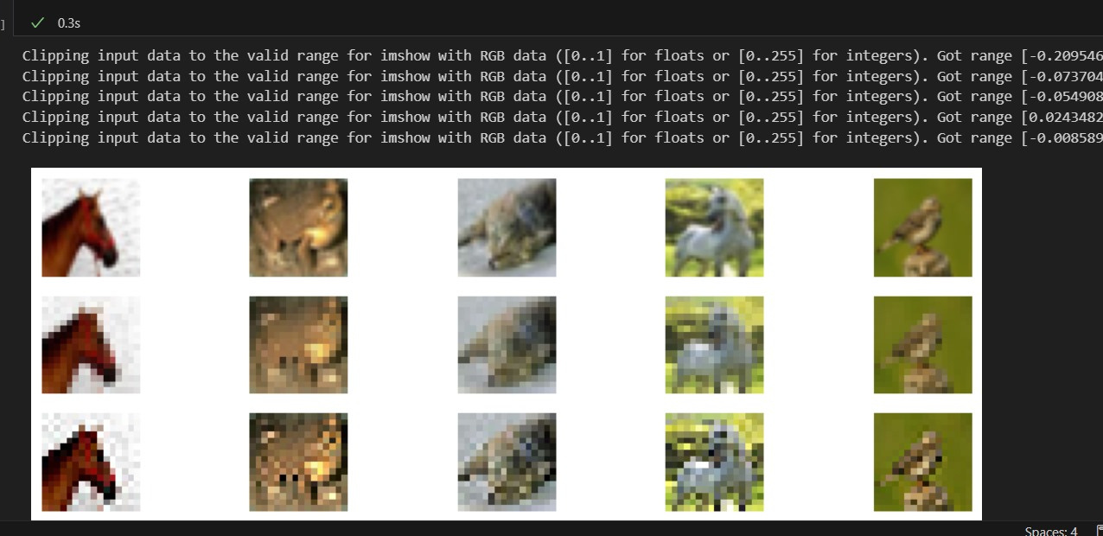

Slide 13



Conclusion
INVERTIBLE CONVOLUTIONAL NETWORKS OPEN NEW POSSIBILITIES FOR EFFICIENT AND VERSATILE MODELS, COMBINING STRONG DISCRIMINATIVE PERFORMANCE WITH ROBUST GENERATIVE CAPABILITIES, MAKING THEM A VALUABLE TOOL FOR FUTURE ADVANCEMENTS IN MACHINE LEARNING.
Invertible Convolutional Networks (ICNs) provide a new approach to neural networks that can be reversed, allowing exact reconstruction of inputs from outputs.
ICNs demonstrated strong potential in Image Reconstruction and Super-Resolution, highlighting their usefulness in applications that require detailed image enhancement and data recovery.
The proposed network modifications maintain classification performance while adding the capability for generative and density estimation tasks, as seen in applications like normalizing flows.

Slide 14


Future Directions
Improved Generative Modeling: Refining the ICN structure for higher-quality image generation and more stable performance in normalizing flows.
Joint Classification and Density Modeling: Integrating ICNs to handle both discriminative tasks (like classification) and generative tasks (like density estimation) within the same framework.
Advanced Applications: Expanding the use of ICNs for tasks like learning Gaussian random fields, feature visualization, and more flexible invertible architectures.

Slide 15


